Slide 1
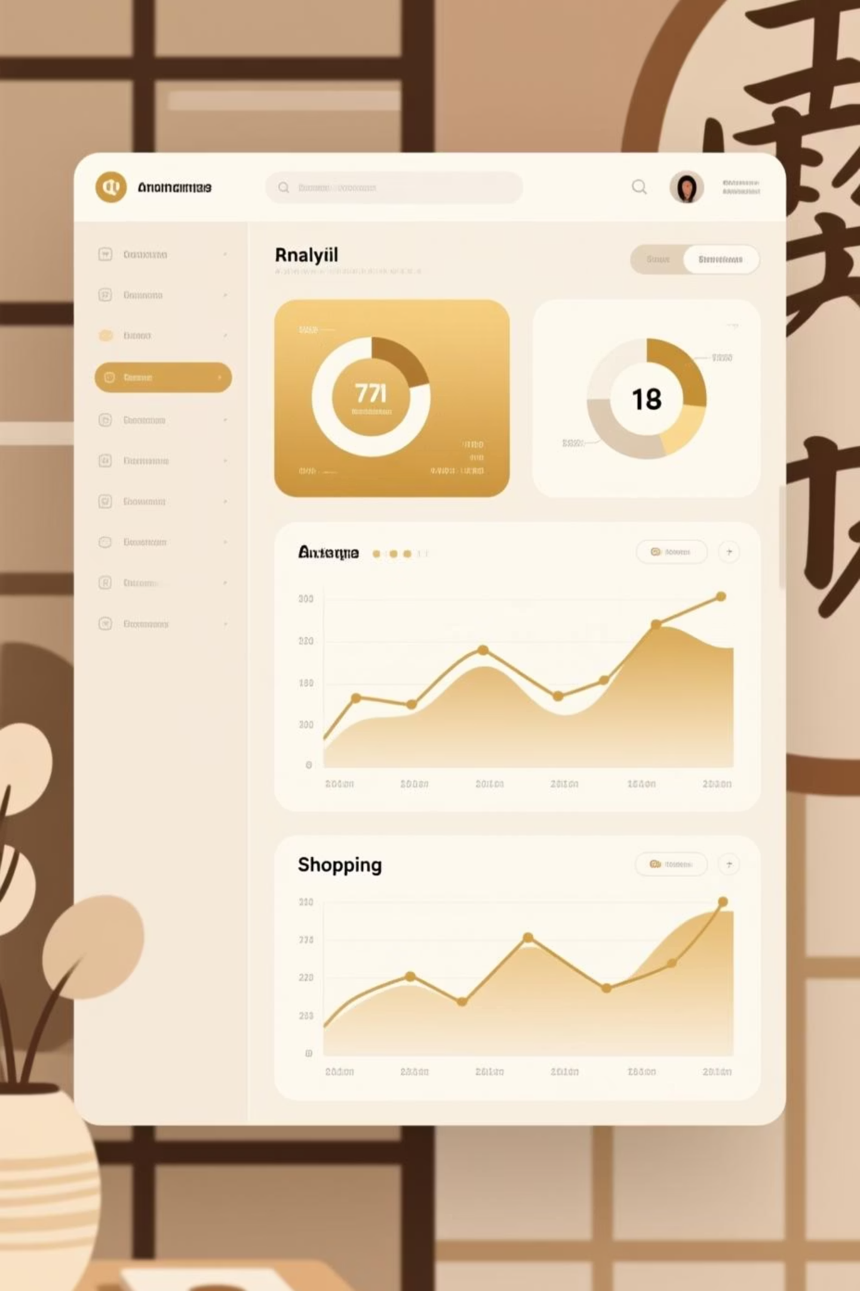
Customer Shopping Behaviour Analysis
Uncovering insights from 3,900 purchases to drive strategic business decisions

Slide 2
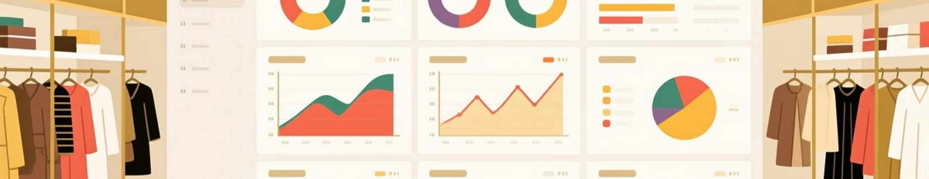
Dataset Overview
3,900
18
50
25
Total Purchases
Data Features
Locations
Product Types
Transactions analyzed across all categories
Comprehensive customer and purchase attributes
Geographic diversity in customer base
Wide variety of items purchased

Slide 3

Data Preparation & Cleaning
Python Analysis Steps
Key Transformations
Loaded dataset with pandas
Missing data: 37 values in Review Rating column handled using median imputation by category
Explored structure and statistics
Imputed missing Review Ratings
Feature engineering: age_group and purchase_frequency_days created
Standardized column names
Created age groups and frequency metrics
Database integration: Connected to PostgreSQL for SQL analysis

Slide 4


Revenue Insights
Male Customers
Female Customers
$157,890 total revenue
$75,191 total revenue
67% of total sales
33% of total sales
68%
32%
Male customer contribution to revenue
Female customer contribution to revenue

Slide 5

Discount Strategy Analysis
High-Spending Discount Users
839 customers used discounts but spent above average
Discount effectiveness varies by product category
Top Discount-Dependent Products
Hat - 50% discount rate
Sneakers - 49.66%
Coat - 49.07%
Sweater - 48.17%
Pants - 47.37%

Slide 6
Product Performance
1
2
3
Gloves
Sandals
Boots
3.86 average rating
3.84 average rating
3.82 average rating
4
5
Hat
Skirt
3.80 average rating
3.78 average rating

Slide 7




Customer Segmentation
Loyal
Returning
New
New Customers
Returning
Loyal
83 first-time buyers
701 repeat purchasers
3,116 frequent shoppers

Slide 8
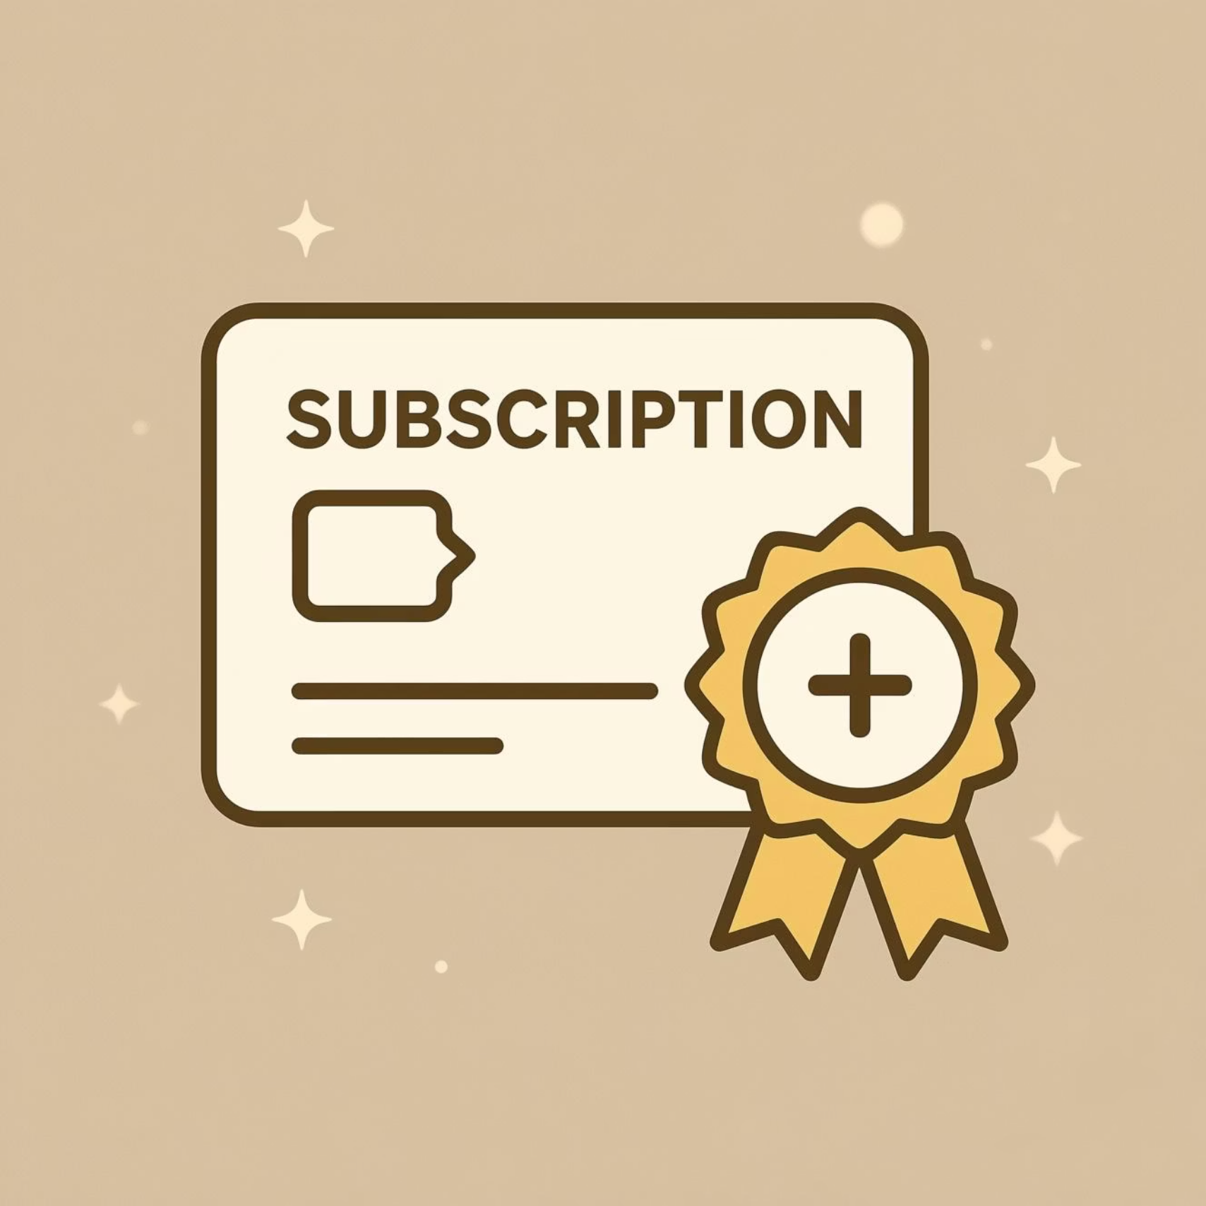

Subscription vs. Non-Subscription
Subscribers
1,053 customers
$59.49 avg spend
$62,645 total revenue
Non-Subscribers
2,847 customers
$59.87 avg spend
$170,436 total revenue
Insight: 958 repeat buyers (>5 purchases) have subscriptions, showing correlation between loyalty and subscription status

Slide 9
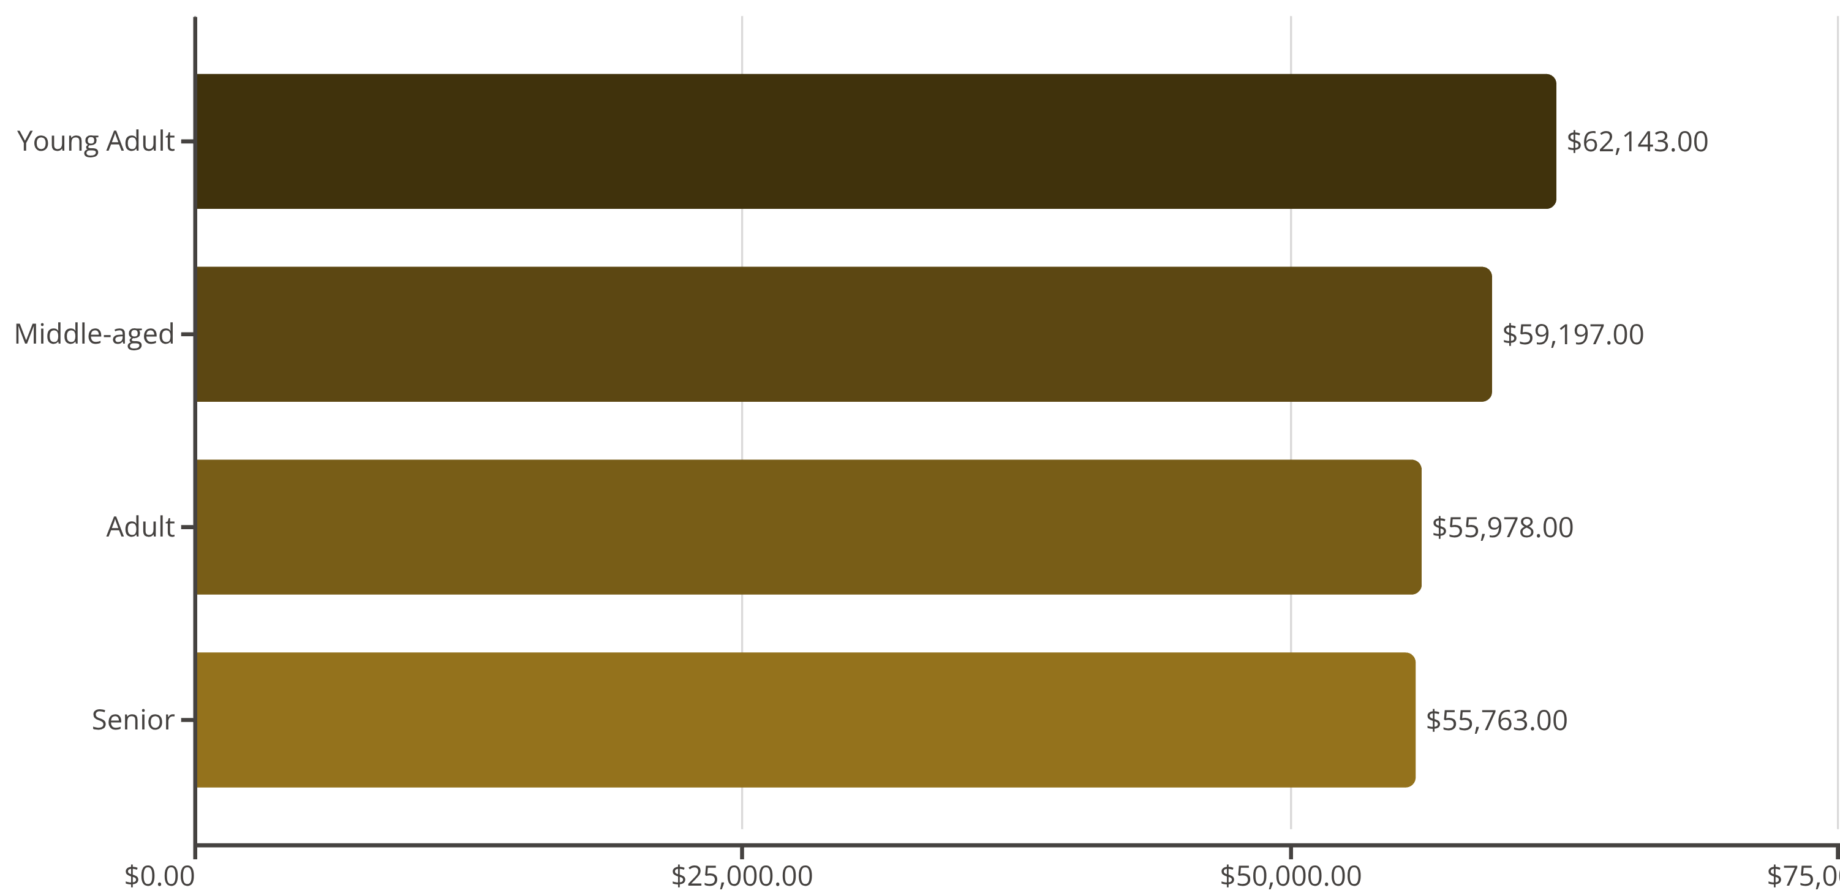
Age Group Revenue Distribution
Young adults lead revenue generation, followed closely by middle-aged customers. Balanced distribution across all age groups.

Slide 10
Strategic Recommendations
Boost Subscriptions
Loyalty Programs
Review Discount Policy
Promote exclusive benefits to convert loyal customers into subscribers
Reward repeat buyers to move them into loyal segment
Balance sales boosts with margin control for sustainable growth
Targeted Marketing
Product Positioning
Focus on high-revenue age groups and express-shipping users
Highlight top-rated and best-selling products in campaigns

